Slide 1
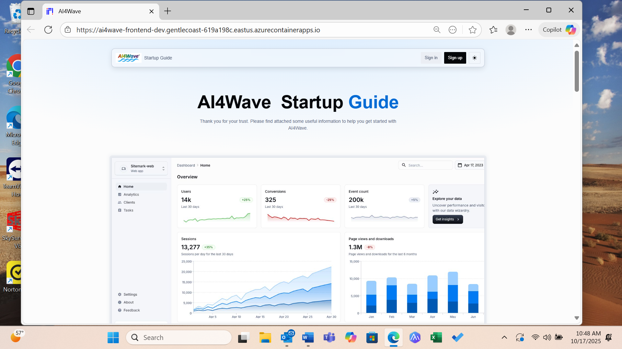
AI4Wave link:
Connect to AI4wave via this link: AI4Wave
Click Sign in to connect

Slide 2
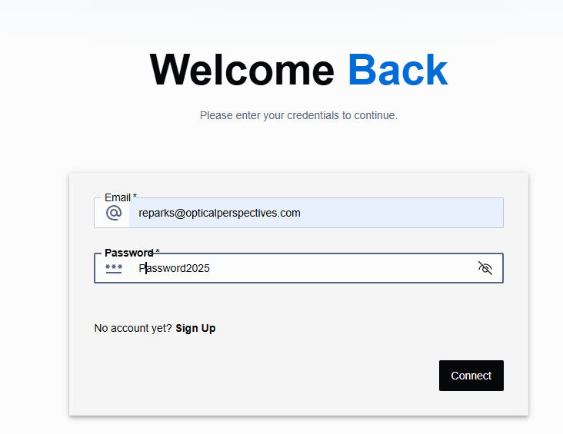
Enter email and password as in the window below: (password is “Password2025”).
Then Click Connect

Slide 3
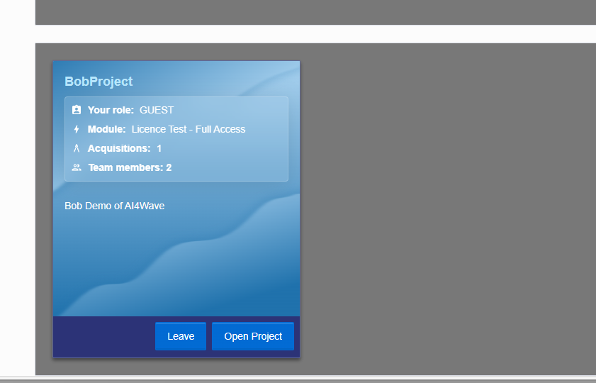
Click Open Project (I have created a project for you named BobProject)

Slide 4
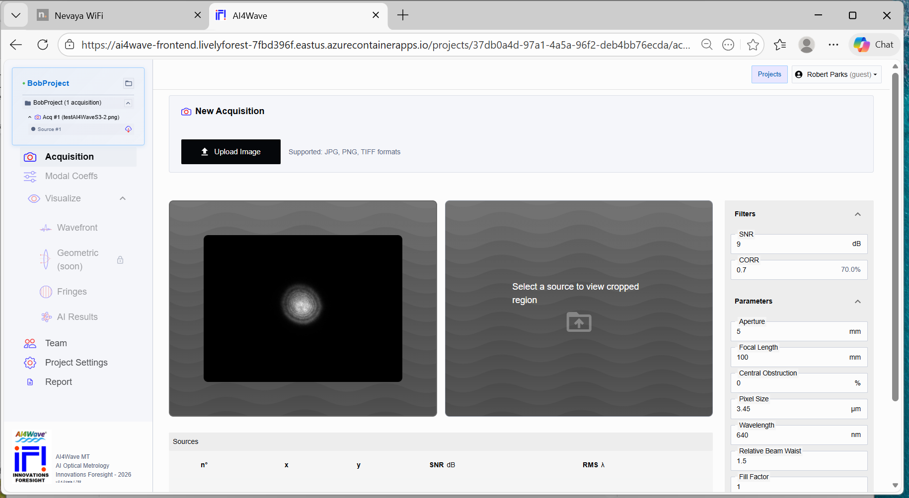
From “Acquision” window Upload a defocused image from PSM.
I also attached an image with multisource for your tests.

Slide 5
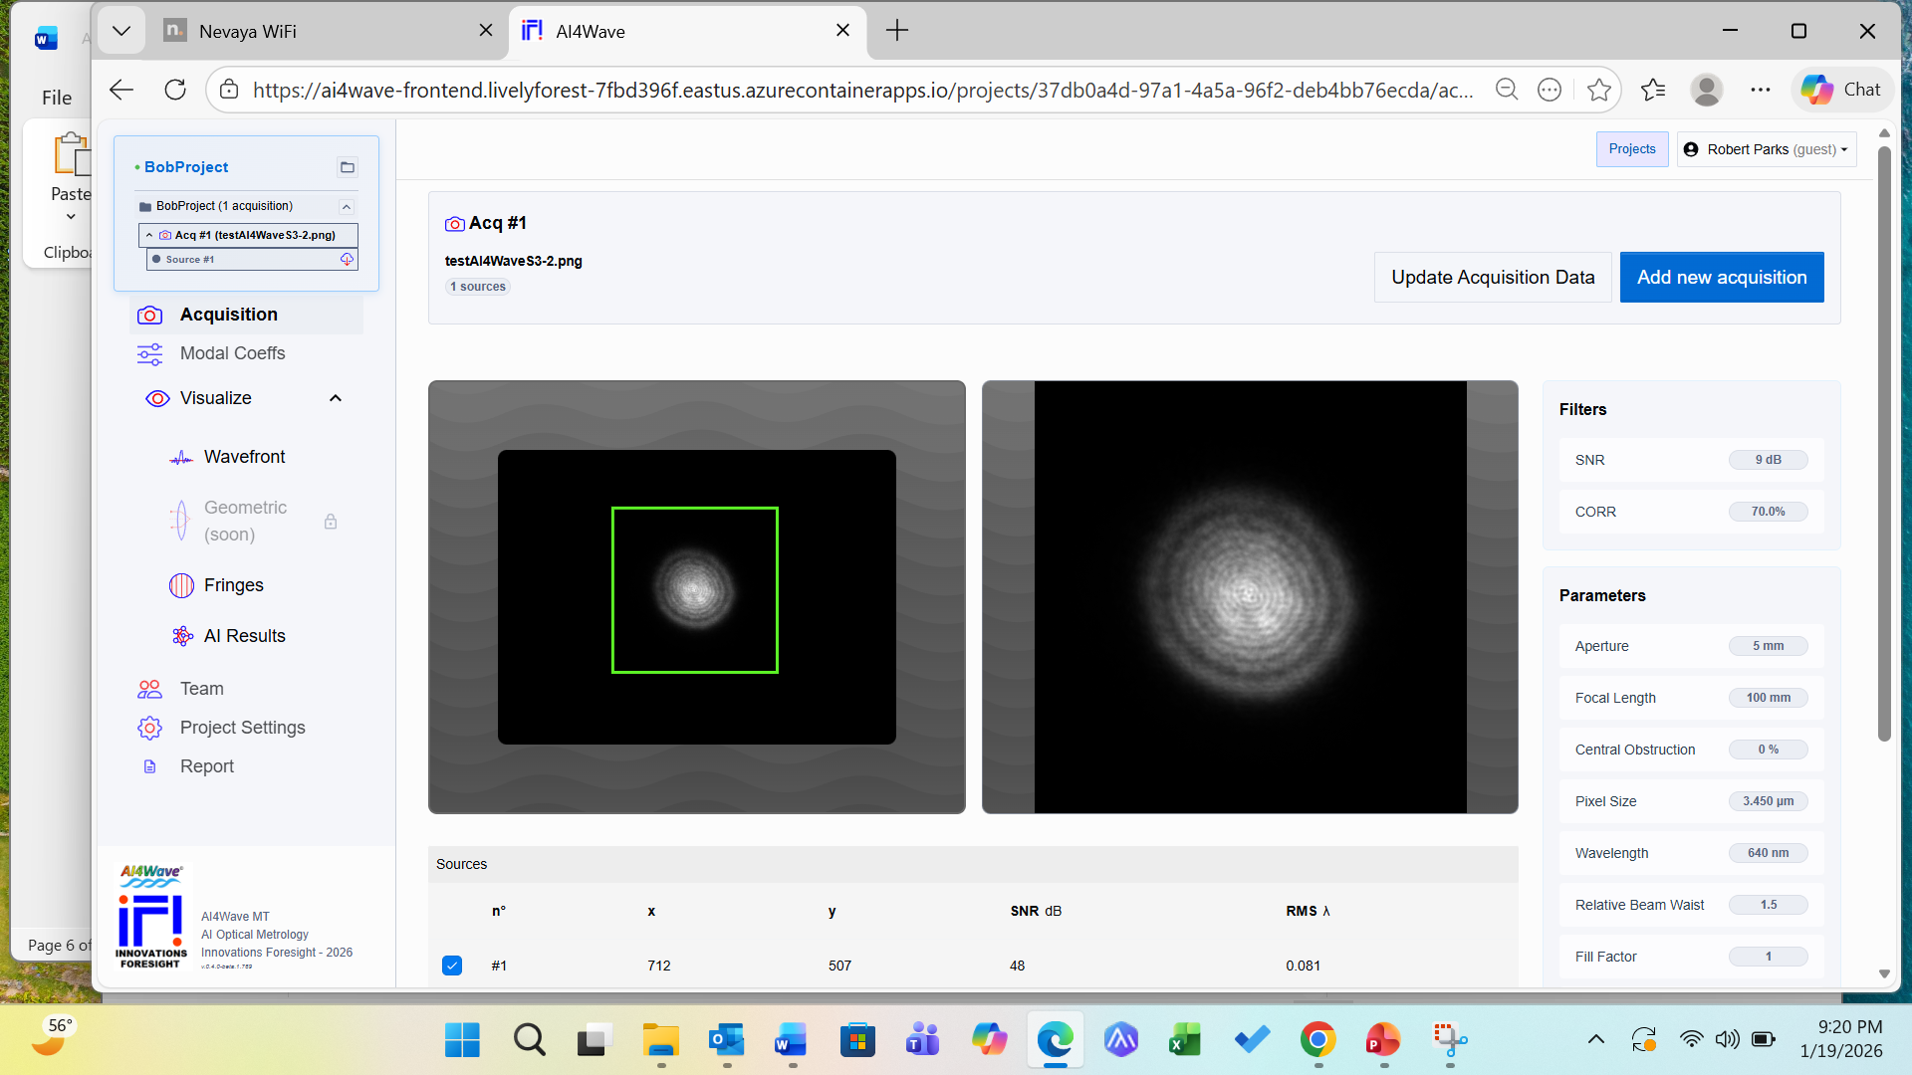
Select the source to analyze
Then click Analyze

Slide 6
